Slide 1
Present insights
By: Pius

Slide 2
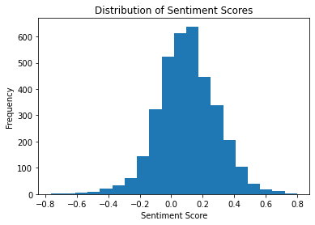
Based on the histogram of sentiment scores, which shows that the majority of reviews are neutral, with a smaller number of highly positive and highly negative reviews. This suggests that while the airline generally meets customer expectations, there is room for improvement to enhance the overall customer experience.

